Slide 1
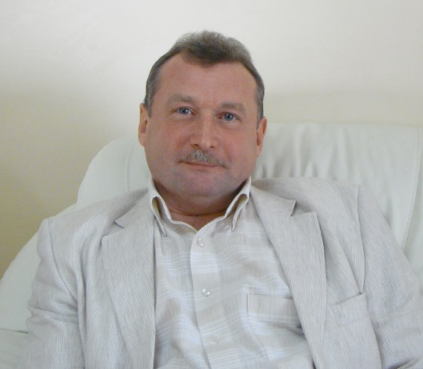
The Federal State-Financed Institution “State Scientific Centre of Laser Medicine under the Federal Medical Biological Agency” of Russia, Moscow, , Department of Rehabilitation and Sports Medicine of Federal State-Funded Educational Institution of Continuing Professional Education “Institute of Advanced Training of FMBA of Russia”
Leading Researcher
Professor
  MOSKVIN SERGEY
BASICS OF LASER THERAPY
Doctor of Biological Sciences
PhD in Engineering Sciences
e-mail: 7652612@mail.ru
http://www.lazmik.ru

Slide 2
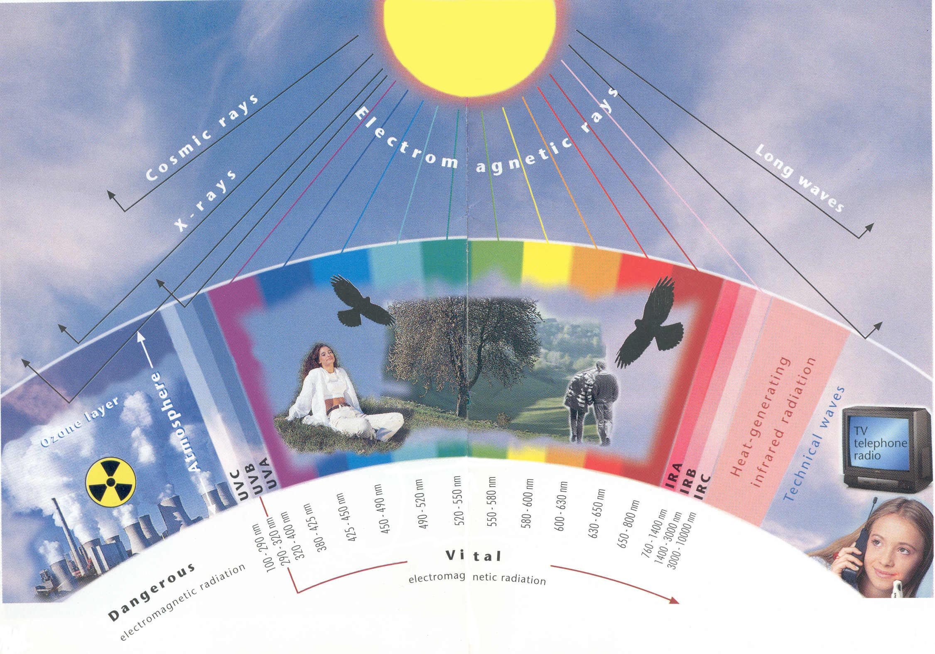
Electromagnetic waves

Slide 3
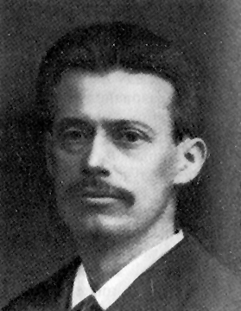
Niels Ryberg Finsen
Nobel Prize in Medicine and Physiology, 1903

Slide 4
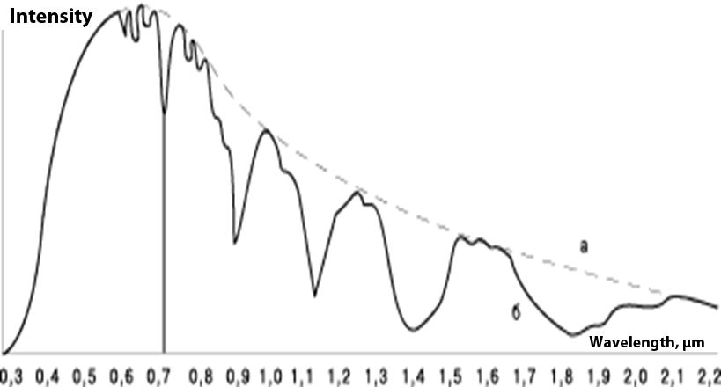
Solar spectrum before (a) and after (b) passing the atmosphere
N. Finsen filtered blue and red
spectrums from a wide spectral
range

Slide 5
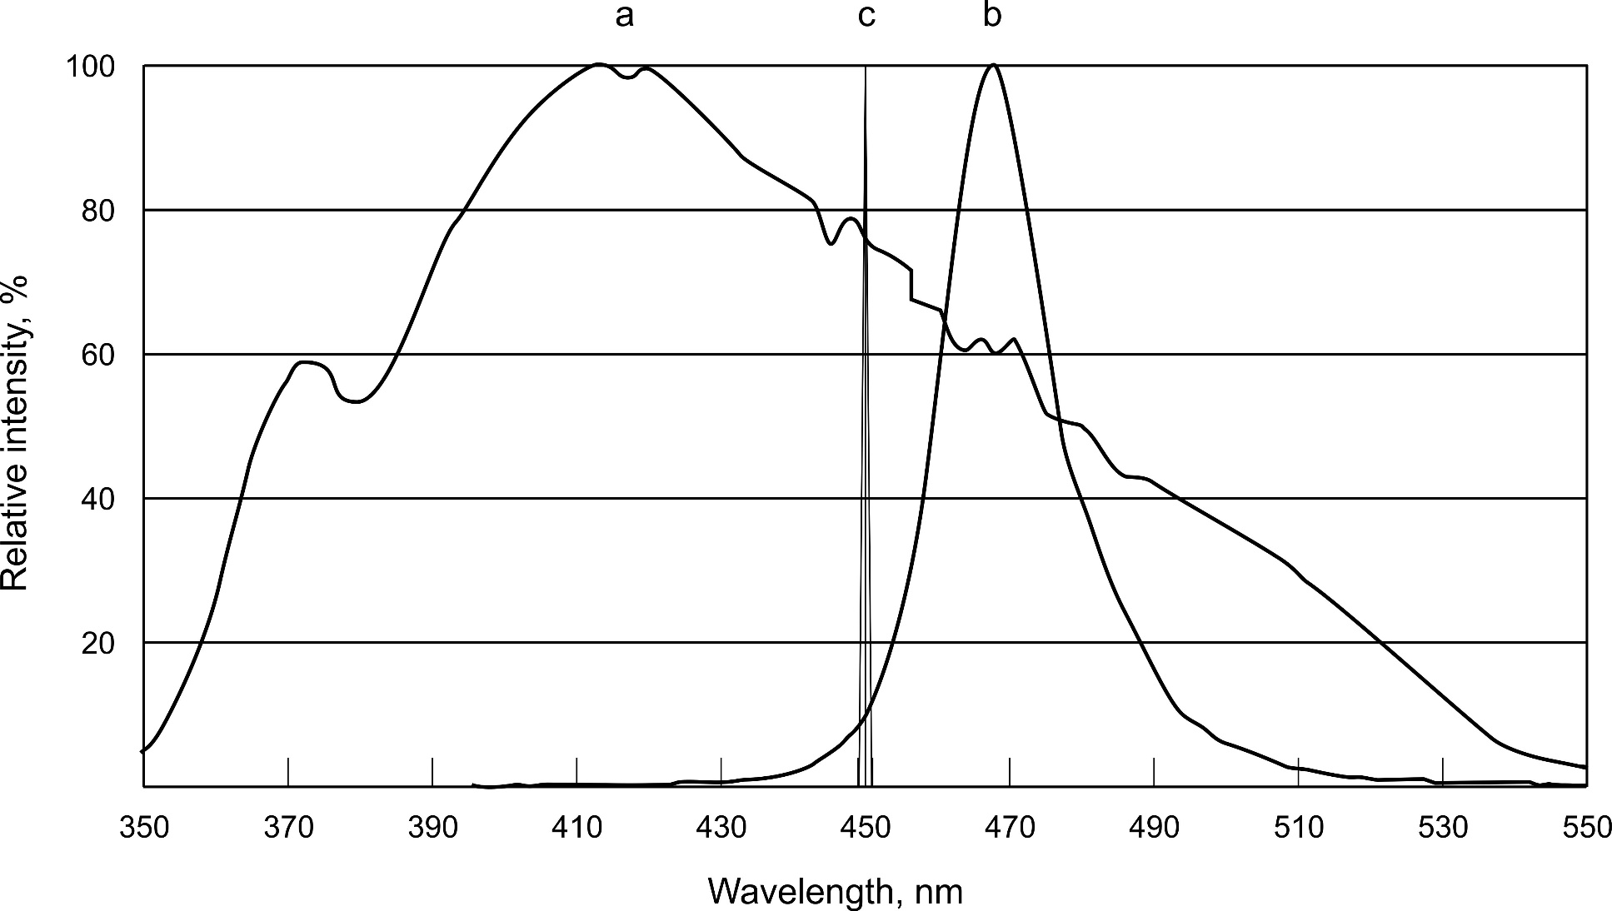
The spectrum width of Finsen’s lamp with filter (a), LED’s (b) lasers (c)

Slide 6
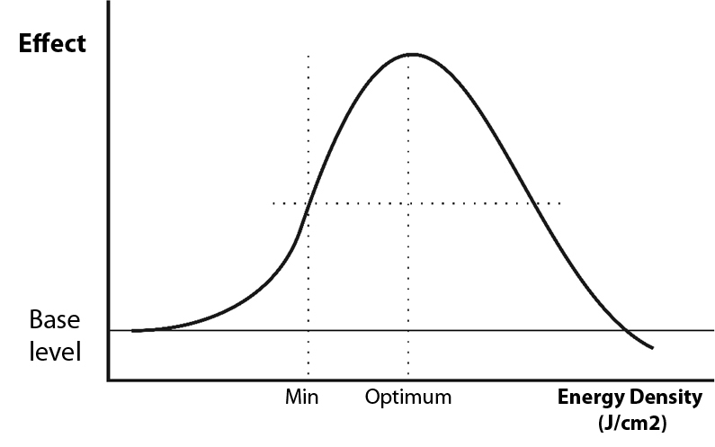
Energy-dependent (biphase) effect of low-intensity laser light (LILI) interaction with biological tissues (ED = T х Pav./S)

Slide 7
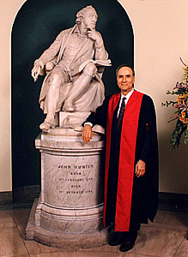
16th May, 1960
Theodore Maiman created the first laser in the world (Ruby, 694nm)

Slide 8
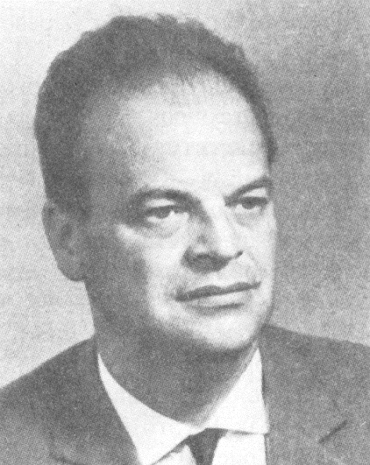
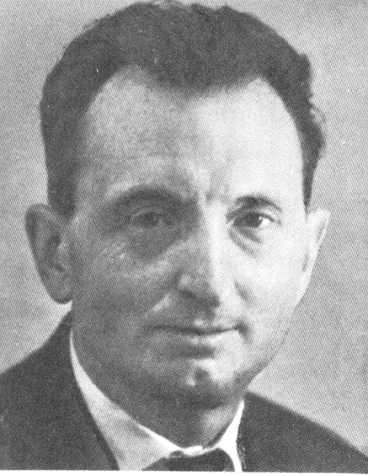
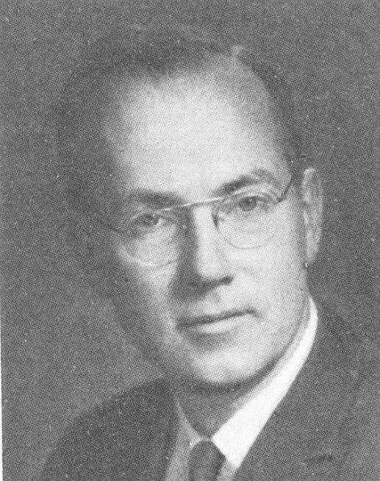
Nikolay G. Basov
(RUSSIA)
Aleksandr M. Prokhorov
(RUSSIA)
Charles H. Townes (USA)
Nobel Prize in physics, 1964

Slide 9
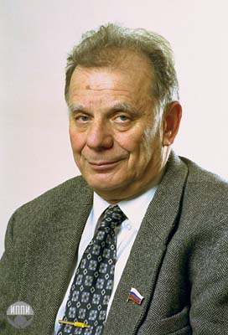
ALFEROV Zhores I.
(RUSSIA)
Nobel Prize in physics (2000)
for creation of laser diodes

Slide 10
Comparison of different parameters of light sources
Sun | No | > 3000 | 40-85
Lamp with filter & LED | Limited | > 30 | < 5
Laser | Yes | < 1 | > 95
Parameter
Energy
control
The width of
spectral line, nm
The degree
of polarization
Source

Slide 11
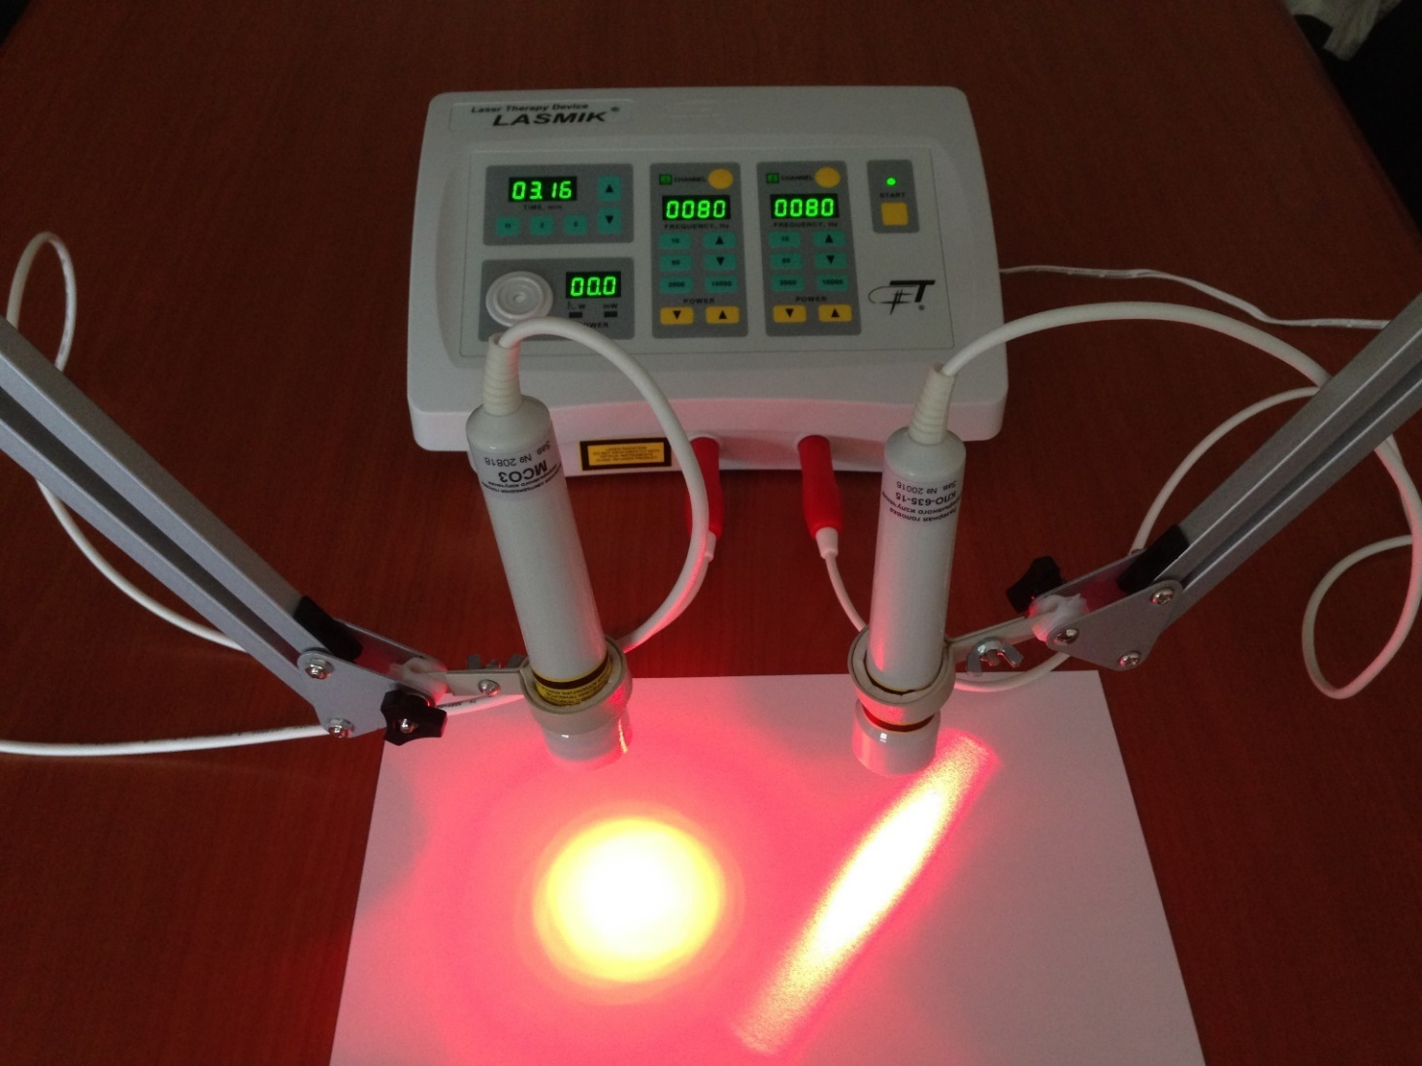
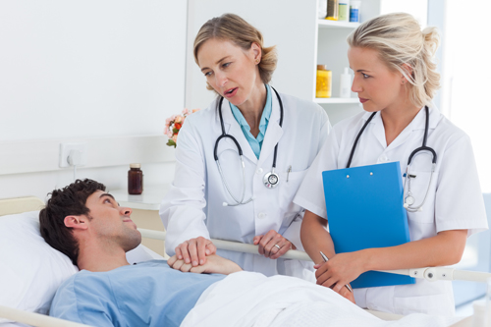
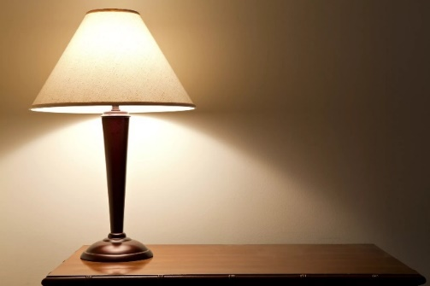
LASER – treatment & health
LED is a lamp

Slide 12
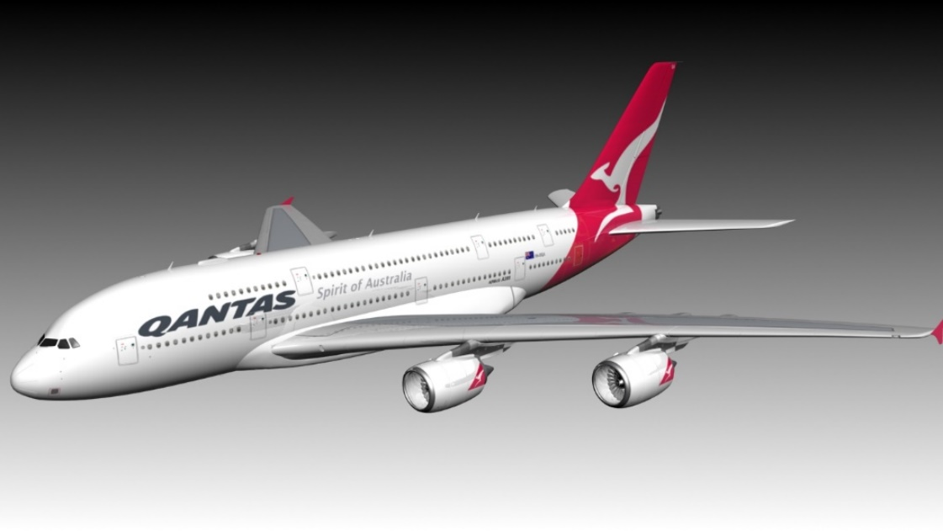
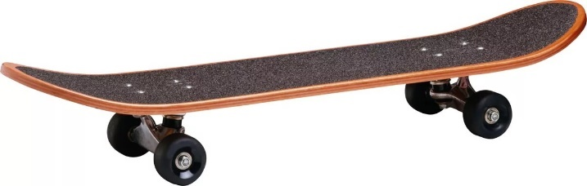
LASER
Light source
Modes of
transport
LED

Slide 13
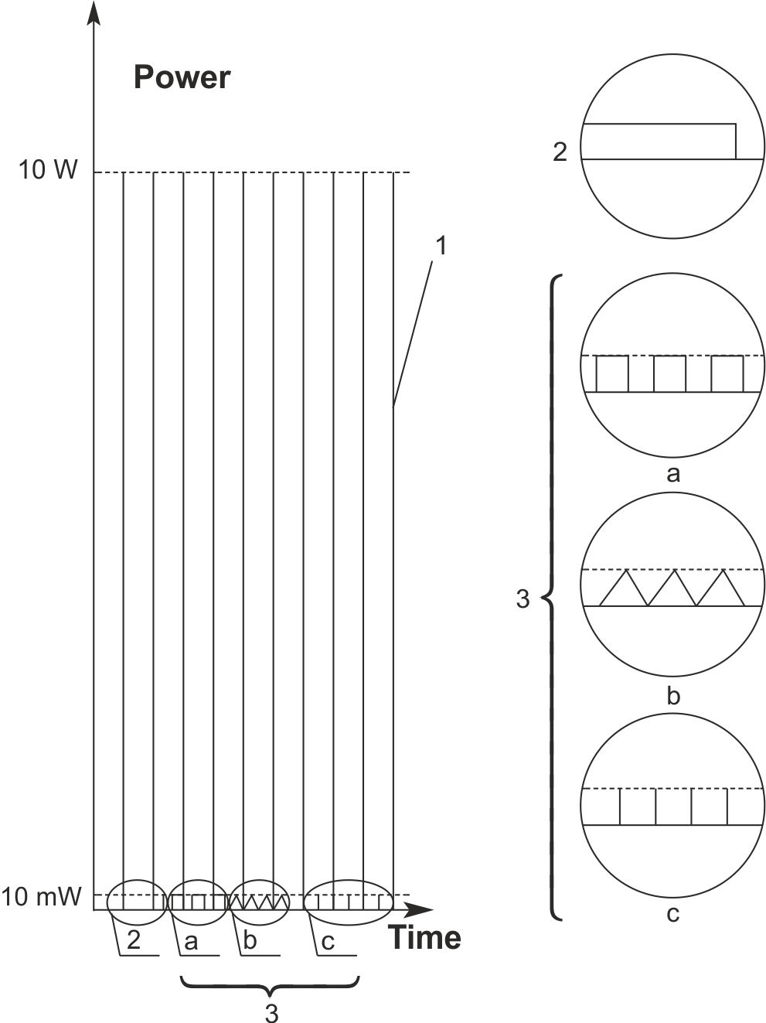
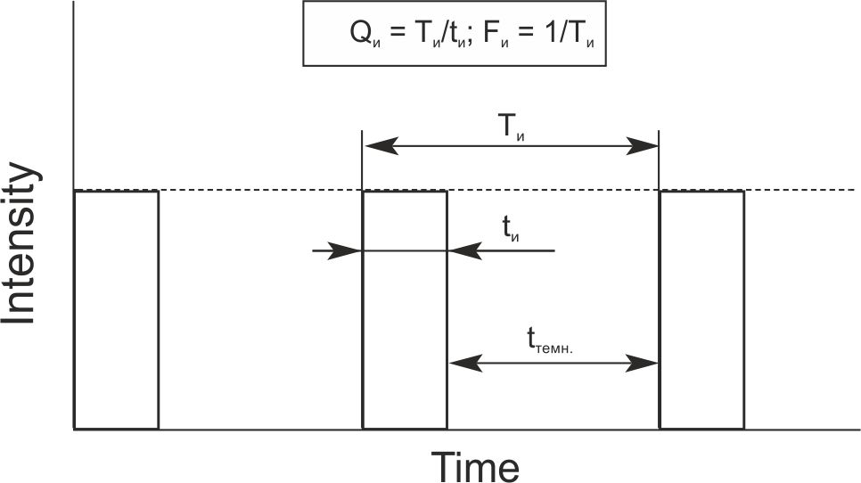
Different illumination modes
P_{av.} = Р_{p.}× τ_{p.} × F
During modulated illumination, average power does not change in the modulation frequency, and in the pulsed mode, laser light it is directly proportional to pulse repetition rate!

Slide 14
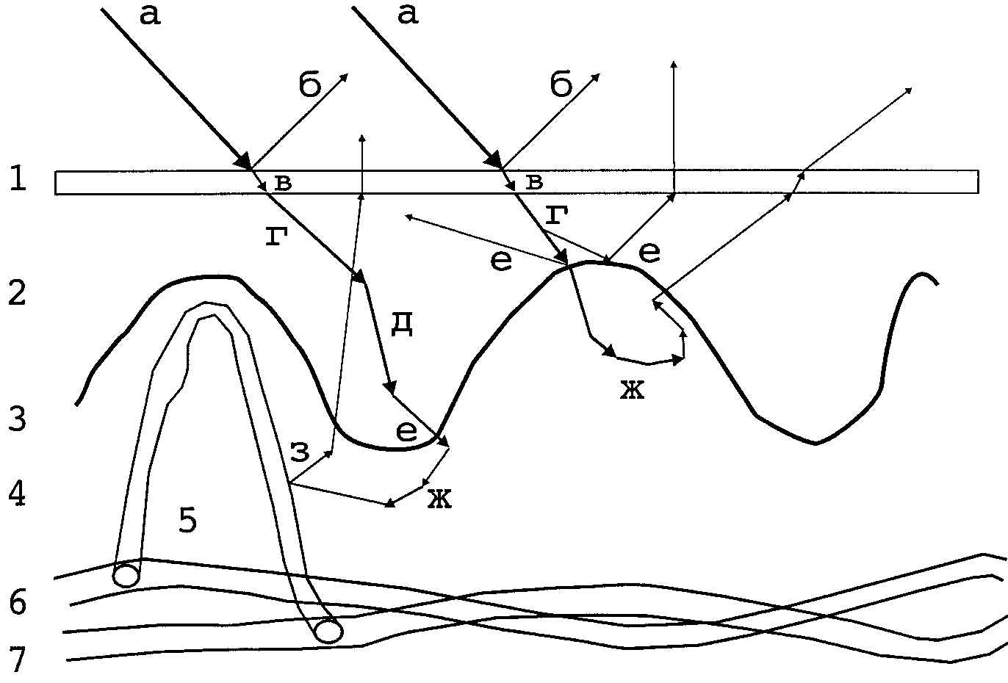
LILI interaction with biological tissues
- Reflection
- Scattering
- Absorption
Skin
ED = P_{av.}• T/S
P = P₀ .e^{-μl}

Slide 15
The parameters of effective
low-level laser therapy
The main rule – all parameters of laser action must be
specified in the following sequence:
– wavelength and mode of operation of the laser;
– average or pulsed power of illumination;
– frequency for pulsed or modulated mode;
– localization and area of impact;
– exposure to the zone and the total time of the procedure;
– number and frequency of procedures.
Area of illumination is distinguished by special nozzles.

Slide 16
The parameters of effective
low-level laser therapy
In laser therapy, there is no such parameter
as "dose" or “dosage”!
There is "energy" = power × time [J] and
"Energy density" = Energy/area [J/cm²].
The arithmetic demonstrations are absolutely not necessary!
They only hinder the effectiveness of laser therapy!

Slide 17
The parameters of effective
low-level laser therapy
The ED may be the same (most often the optimal 1J/cm²)
in three different situations (assuming a contact-mirror technique
and an effective area of 1cm²):
the power of 1mW is multiplied by the exposure time 1000 seconds
(about 15 mins) = 1J/cm²;
2) the power of 1000mW is multiplied by the exposure time
1 second = 1J/cm²;
3) the power of 10mW is multiplied by the exposure time 100 seconds
(about 1.5 minutes) = 1J/cm².
But the effect, i.e., a positive result of the treatment, will be ONLY
in the 3rd case, when all the optimal parameters are given,
and even then, only for lasers of continuous operation with
a wavelength of 635nm (red spectrum).
In options 1 and 2, there will be no curative effect
for any laser or mode of operation!!!!

Slide 18
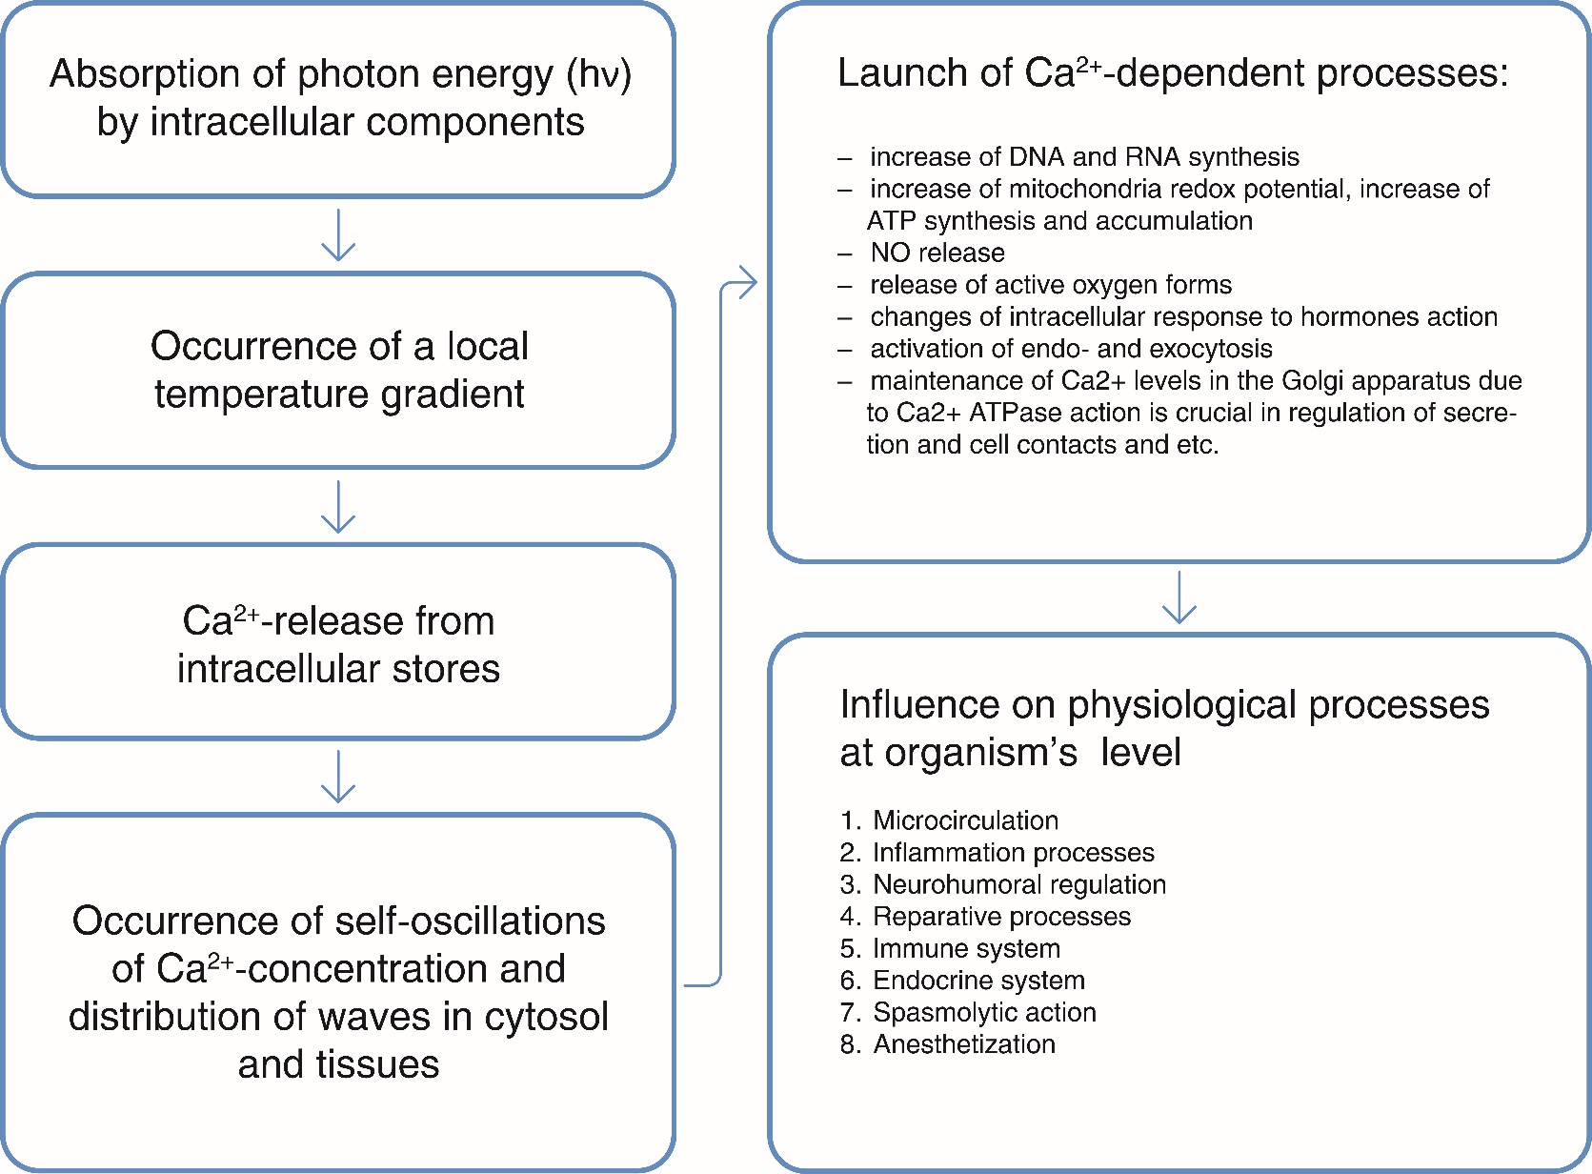
The sequence of the development of biological effects
of laser exposure

Slide 19
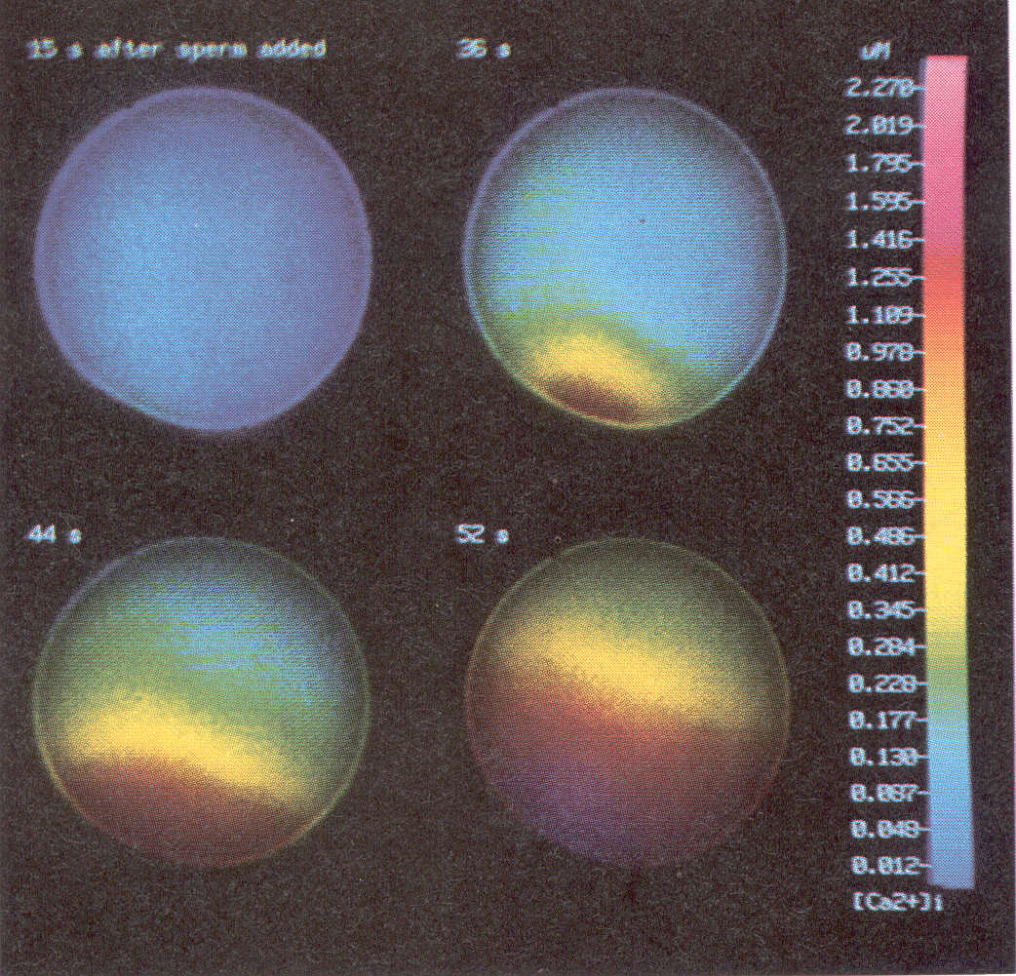
Intracellular Ca²⁺ oscillations evoked by laser light
(Alexandratou E., Yova D., Handris P. et al. Human fibroblast alterations induced by low power laser irradiation at the single cell level using confocal microscopy // Photoch. & Photob. Sciences. – 2002, 1 (8). – P. 547-552.)
Mitochondrial redox-potential
300
140
Ca²⁺ concentration
250
130
200
120
150
110
100
100
50
90
100
200
300
400
500
Time, s

Slide 20
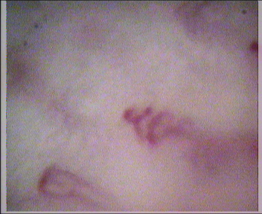
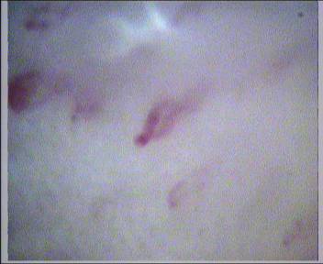
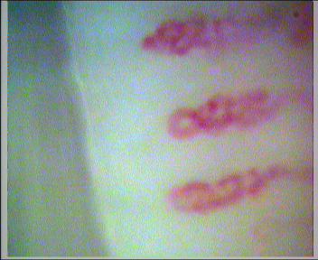
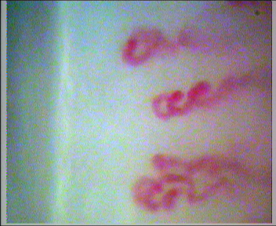
A patient suffering from type 2 diabetes (about 4 years) before treatment (depleted capillary network,
reduced blood flow, capillary deformation typical of diabetic microangiopathy)
The same patient after ten sessions of LLLT – increase of capillary network density, blood flow velocity,
form of capillaries (study material - prof. Duvanskiy V.A.)

Slide 21
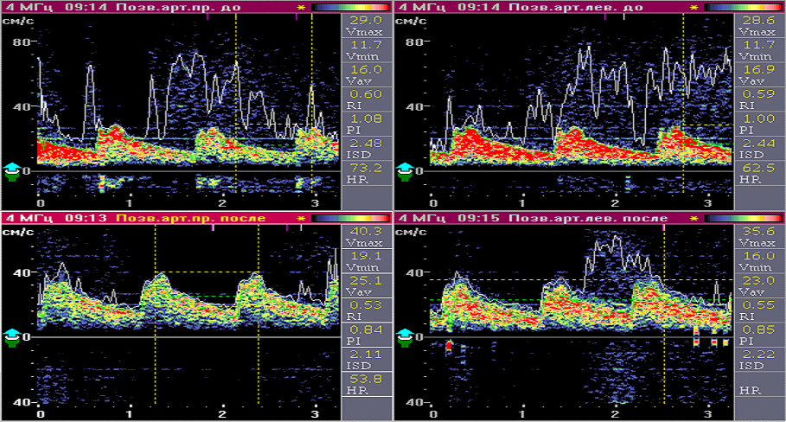
  USDG (ultrasound dopplerography) dynamics after a course of matrix laser therapy.
  Arteriodilatate effect.

Slide 22
Main mechanisms of LLLT biological action
at the organismal level
Activation of microcirculation
NO – precursor of cell-derived factor of endothelium blood vessel walls relax (EDRF – Endothelium derived relaxing factor),
Subsidiary microcirculatory bloodstream is used
2. Anti-inflammatory effect
Change of PG, decrease of PGE₂ and increase of PGF_{2α} level
Alignment of osmotic pressure due to strengthening of microcirculation
Reducing swelling of tissues
Change of ACTH level
Release of cytokines - proteins which transfer signals between lymphocytes, phagocytes and other cells (interferons, interleukins, TNF TFRβ - inflammatory mediators)

Slide 23
Main mechanisms of LLLT biological action
at the organism level (part 2)
3. Analgesia
Increase of endorphins and enkephalins production
Activation of neuronal metabolism
Increase of pain threshold
4. Stimulation of reparative processes
Increase of mitochondrial redox-potential
Increase of ATP synthesis
Reduction of G₁ phase of the cell cycle
Activated transition from G₁ to S₀ phase
Increase of fibroblast proliferation, release of bFGF
Epithelialization, collagen and protein synthesis, capillaries growth and etc.

Slide 24
Main mechanisms of LLLT biological action
at the organismal level (part 3)
5. Immune stimulation
Increase of immune cells (leukocytes) proliferation
Acceleration of immune cells aging
Changes in the ratio of T-helper / T-suppressor
Increase of Ig production
6. Reflexogenic action
Irritation of nerve endings
Excitation of nerve centers
Stimulation of physiological functions
7. Antispasmodic action
Change of Са²⁺ via a large family of transient receptor proteins (TRP) ion channels enables the reduction or relaxation of smooth muscles

Slide 25
Main laser therapy techniques
1. External :
locally (percutaneously) stably
locally (percutaneously) labile
on acupuncture points
on Zakharyin-Ged zone
paravertebrally
on the projection of internal organs
on the projection of vascular bundles
on the projection of immune organs
2. Abdominal procedures
3. Intravenous laser illumination of blood (ILIB)
4. Associated:
magnetic laser therapy
laser-vacuum therapy
local laser negative pressure
vibromagnetic therapy
laserphoresis

Slide 26
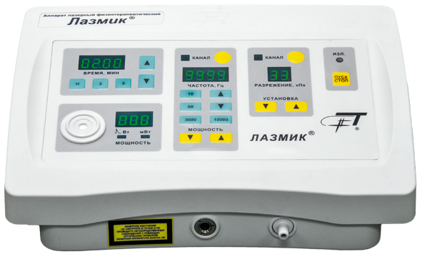
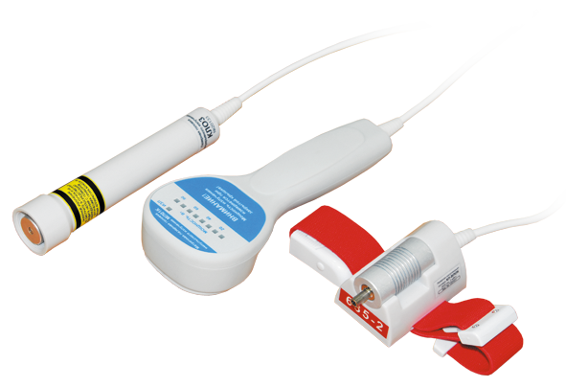
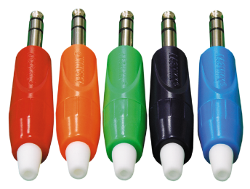
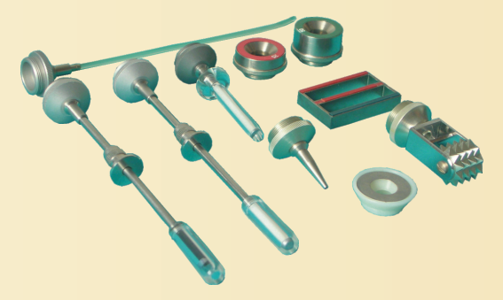
Building-block concept of laser therapeutic devices

Slide 27
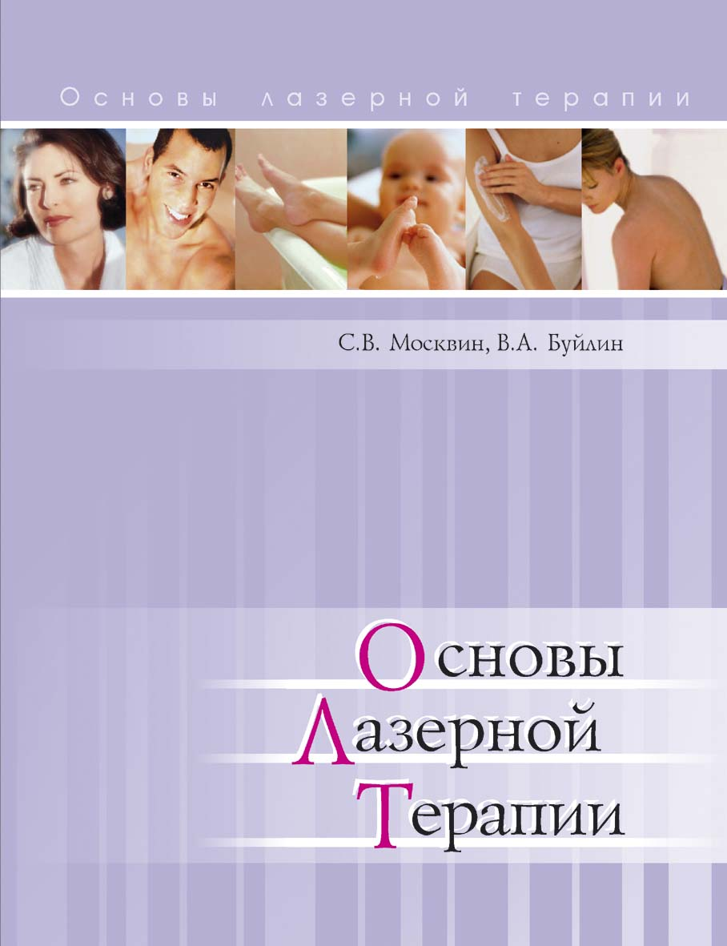
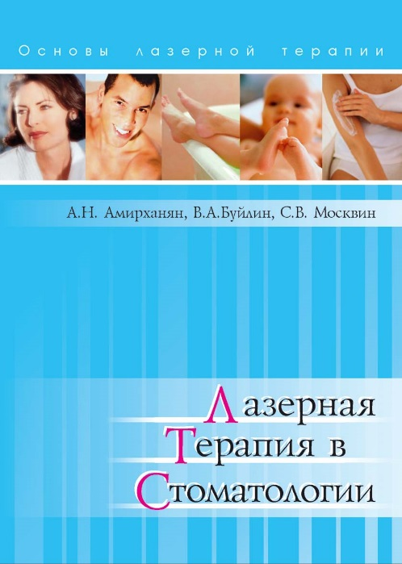
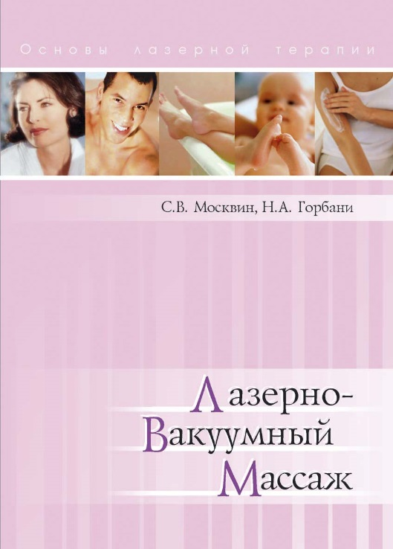
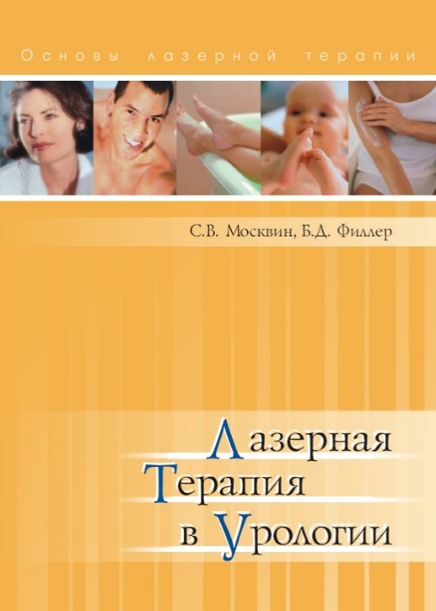
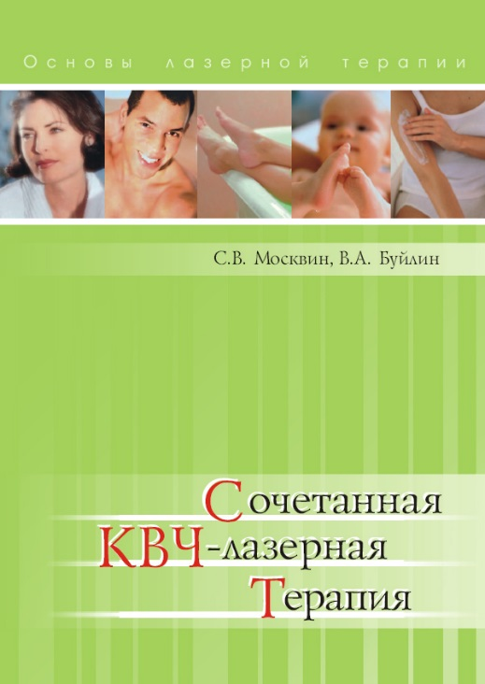
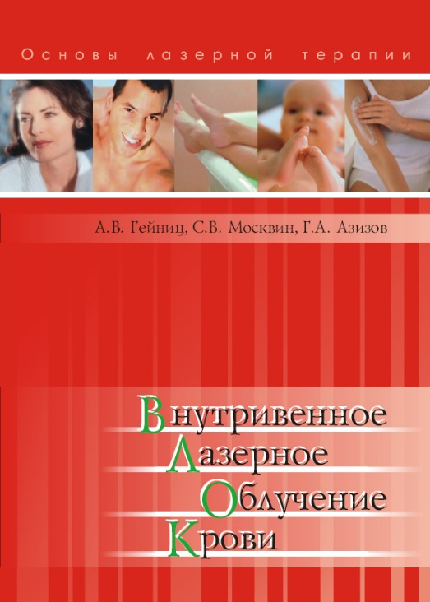
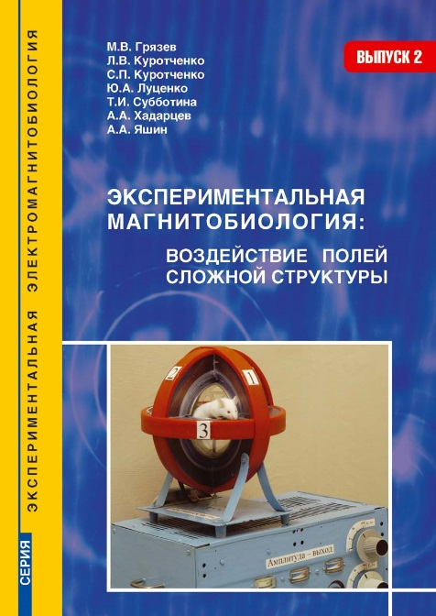
Research Center
«Matrix»
Literature
on laser therapy

Slide 28
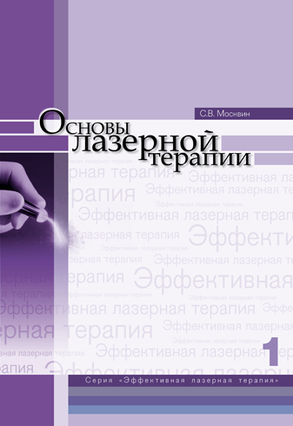
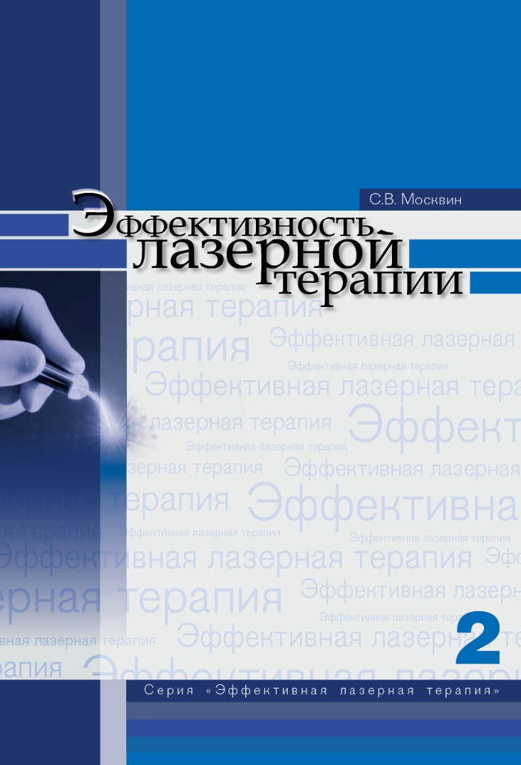
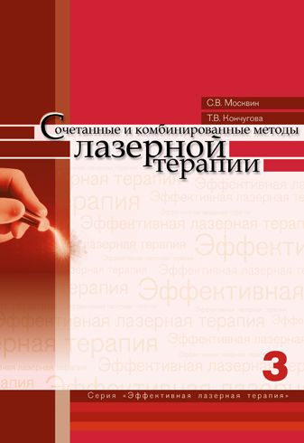
«Effective
laser therapy»
A new series
of books

Slide 29
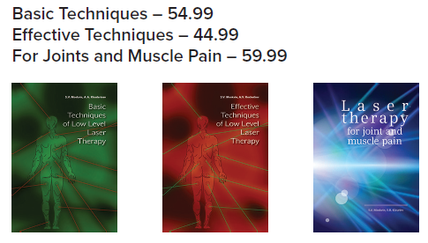
Best books for laser therapy

